Slide 1
The Game of Chess Showcase

Slide 2
Use of fundamental OOD concepts
Inheritance
Getters
Setters
Attributes
Methods
Modularity
Overloading

Slide 3
Use of at least 3 design patterns
Strategy – Different implementations for different pieces
Possible moves
Protect moves
Observer – When pieces change, so does the board
Piece locations
Highlighted squares
State – States for each piece and each end game
Pieces/Move possibilities
Check/Checkmate/Stalemate

Slide 4

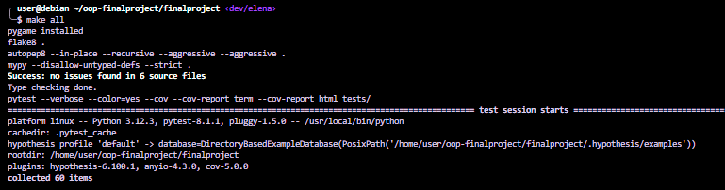
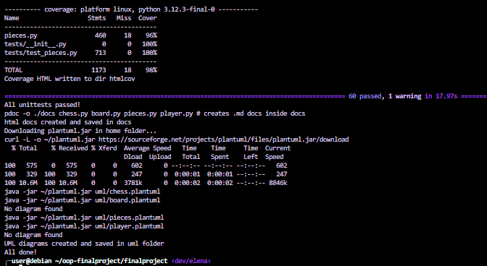
Testing for correctness

Slide 5
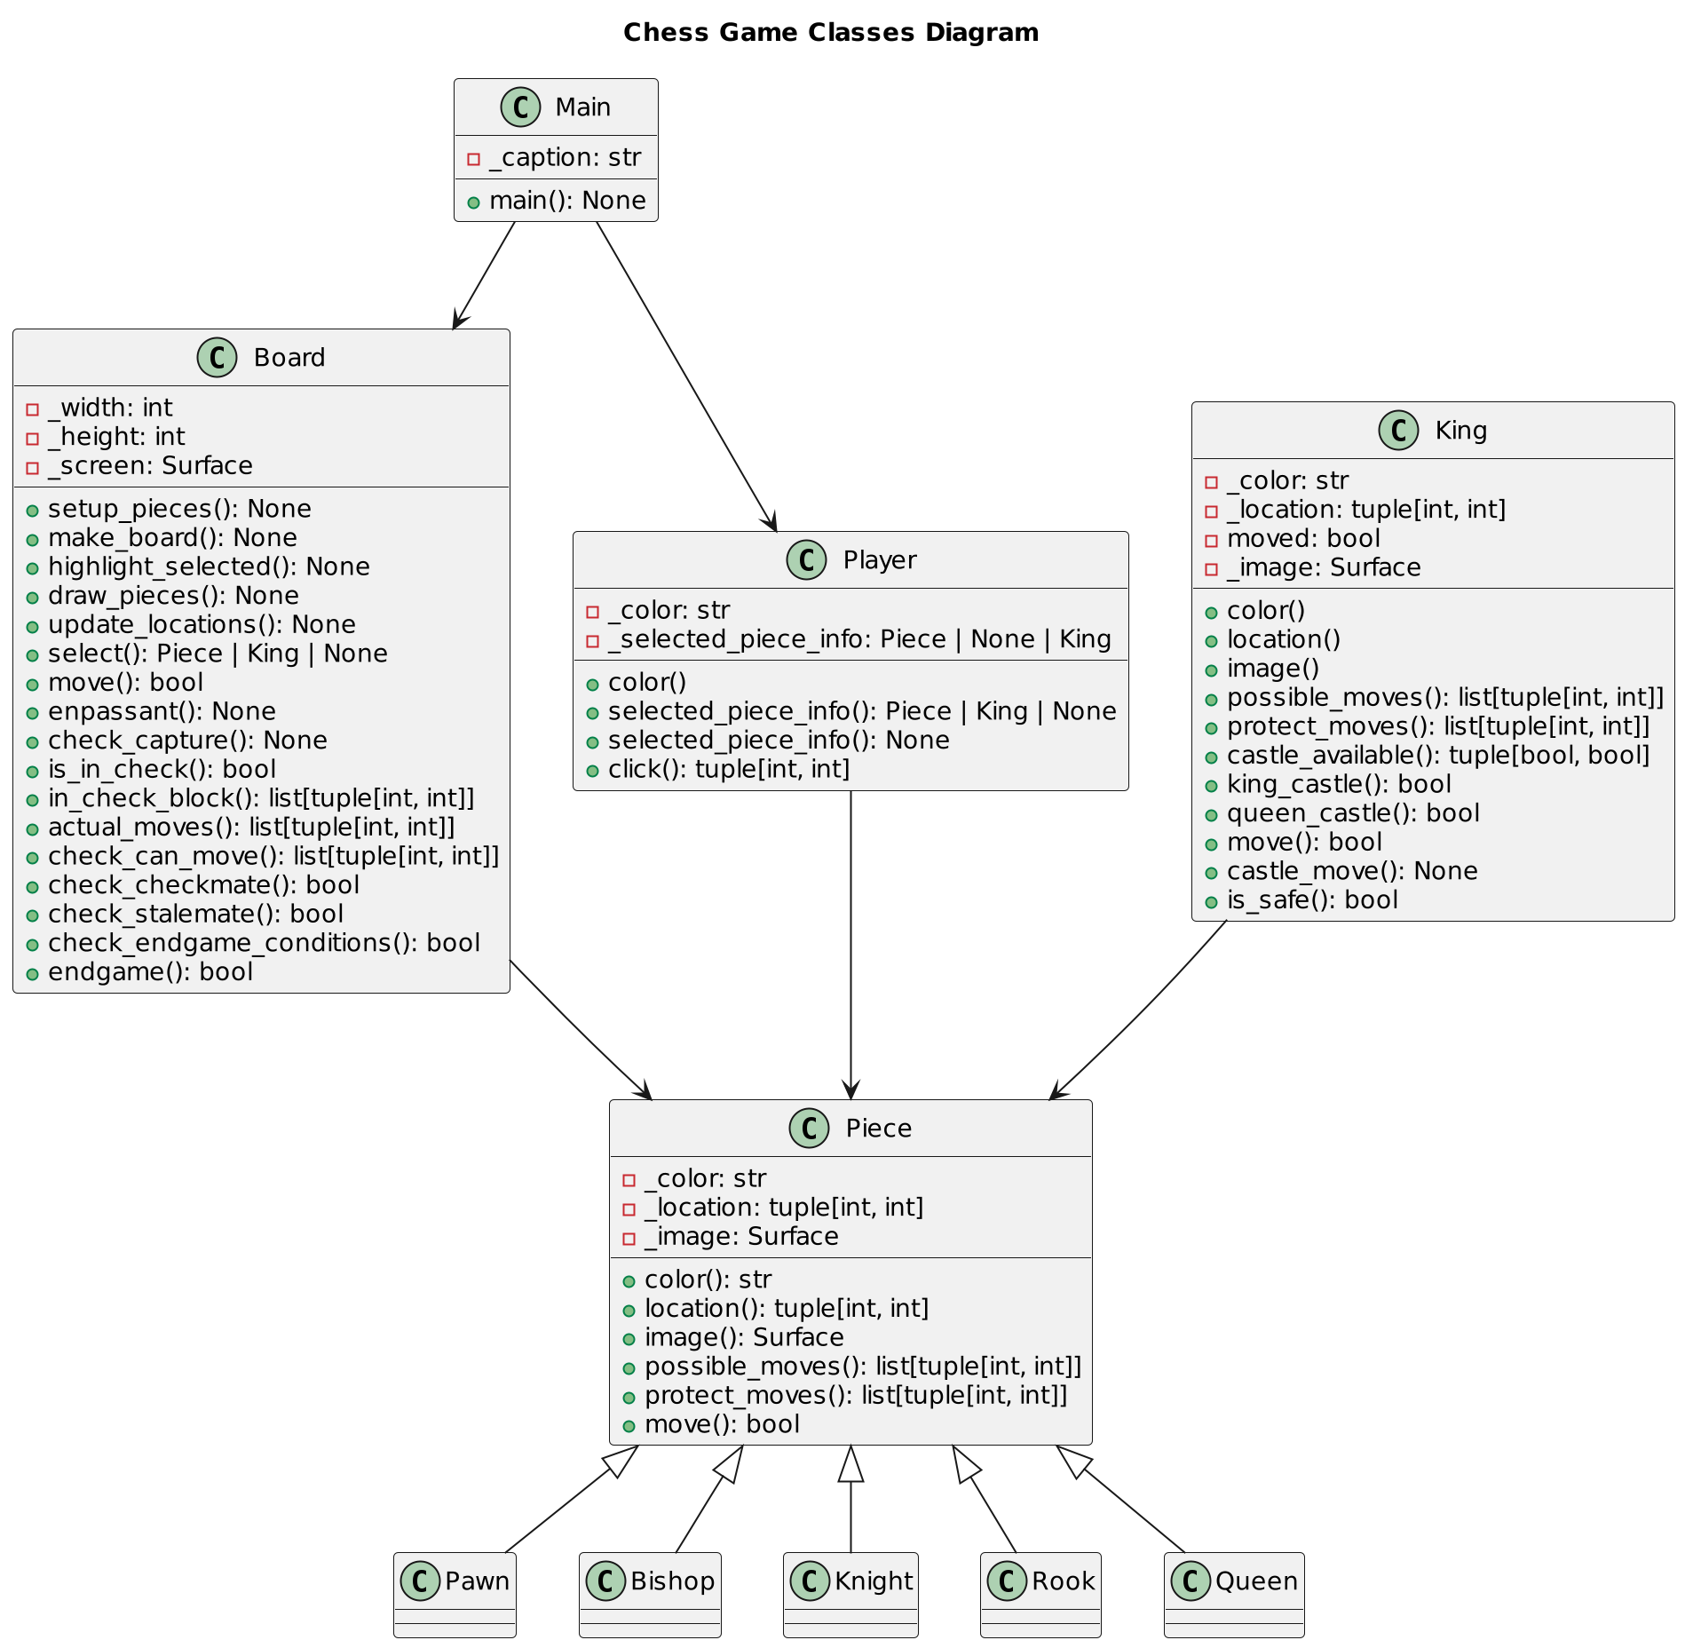
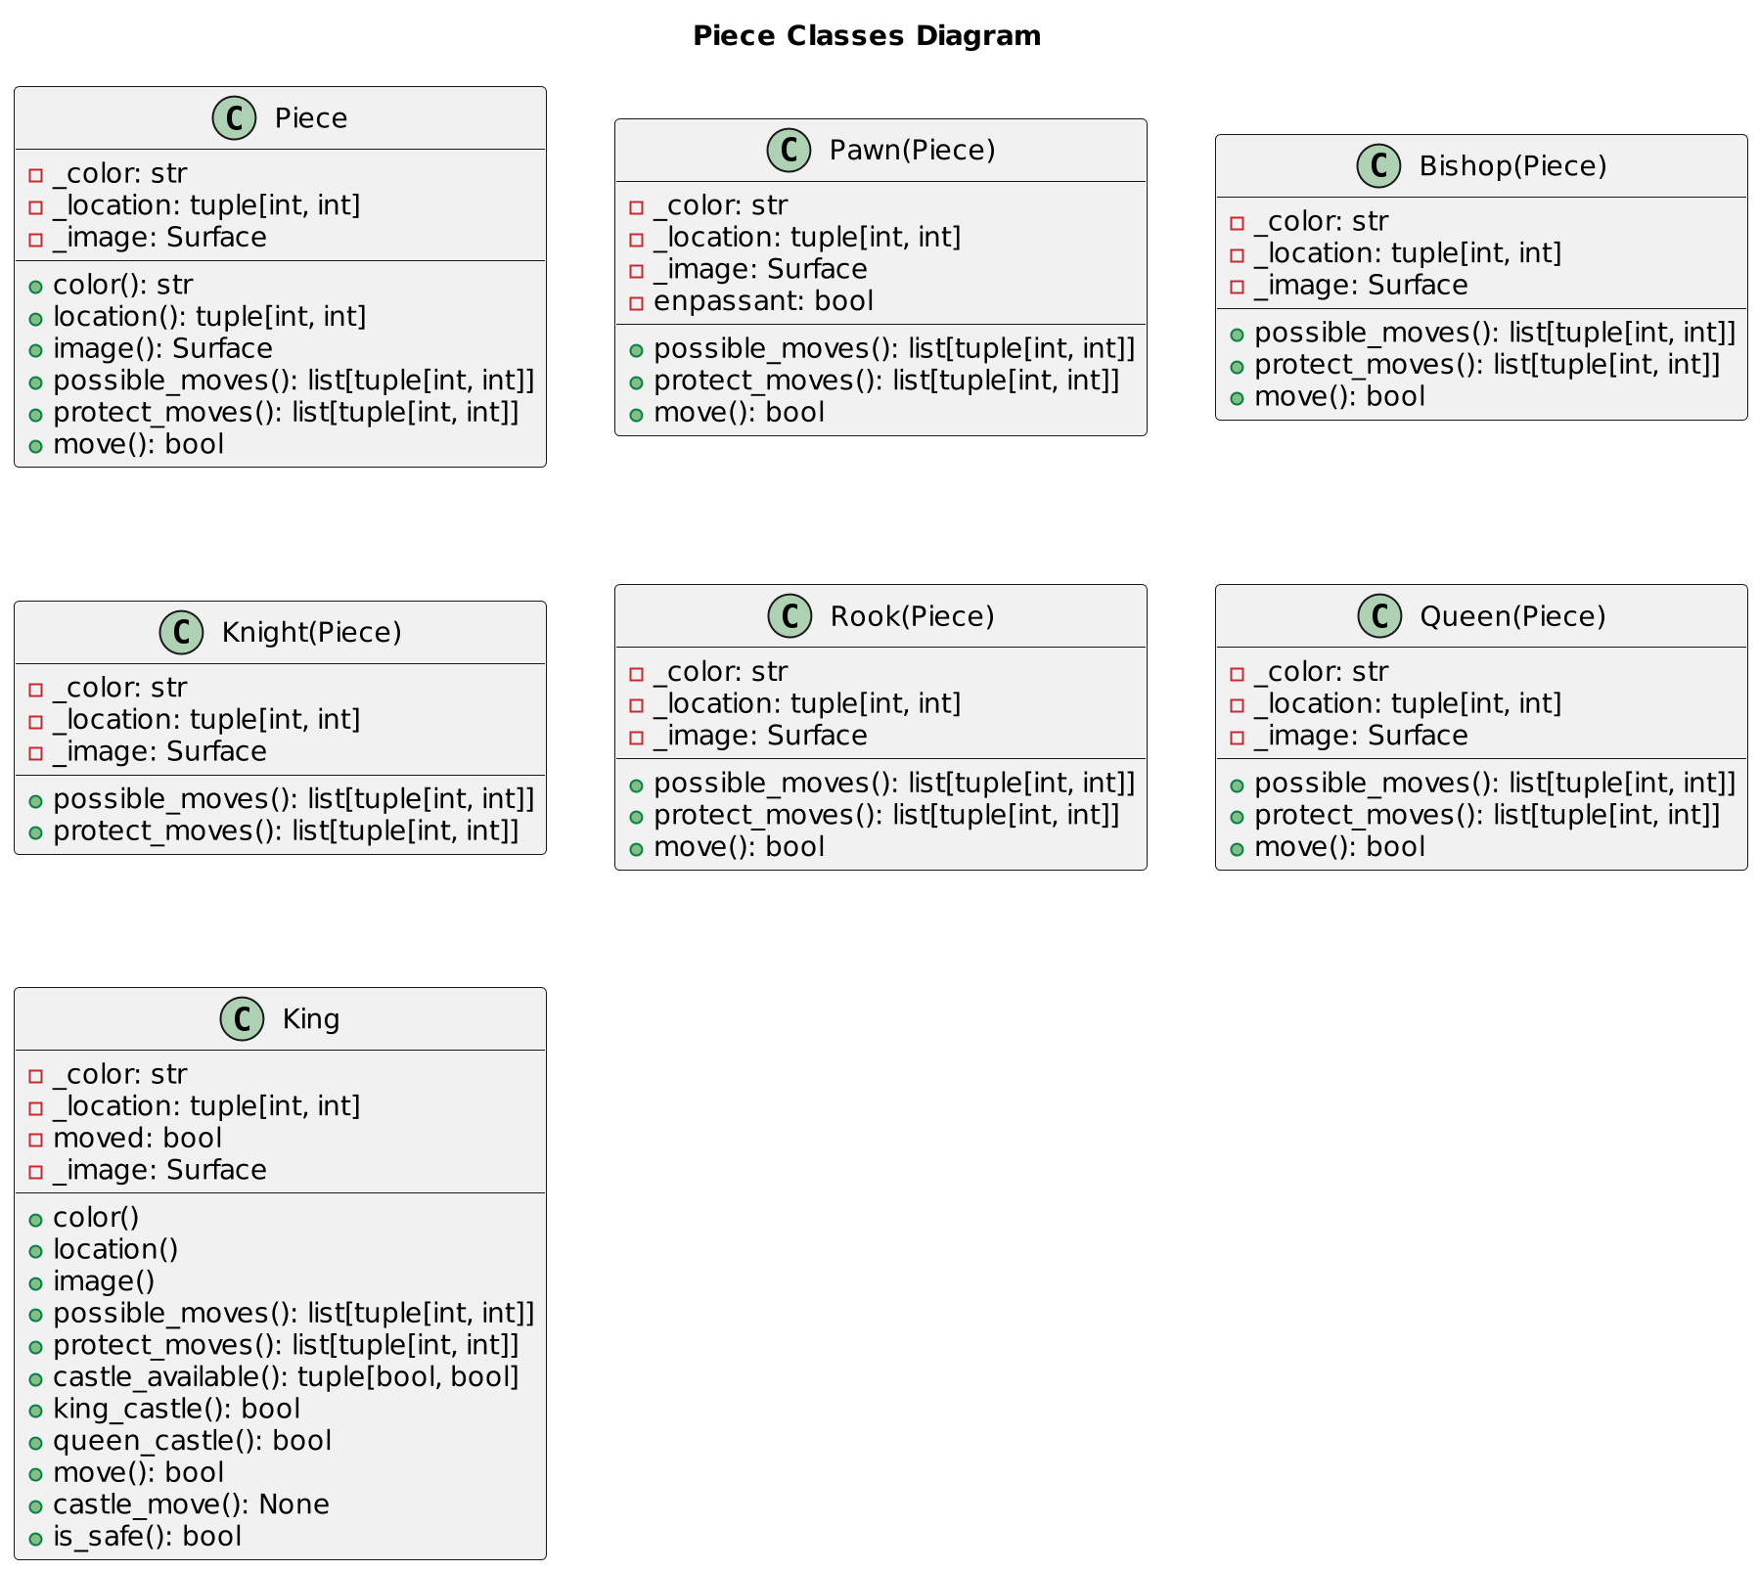
Documentation

Slide 6
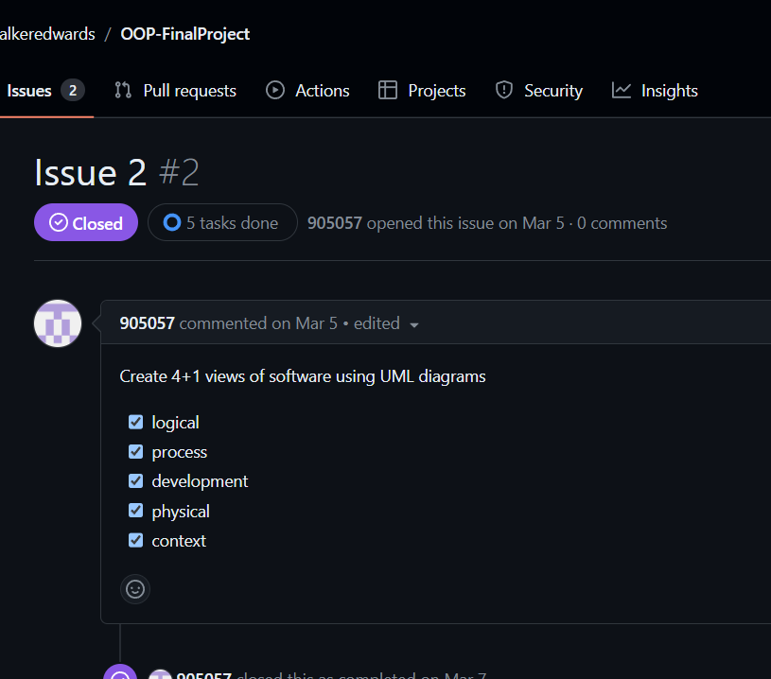
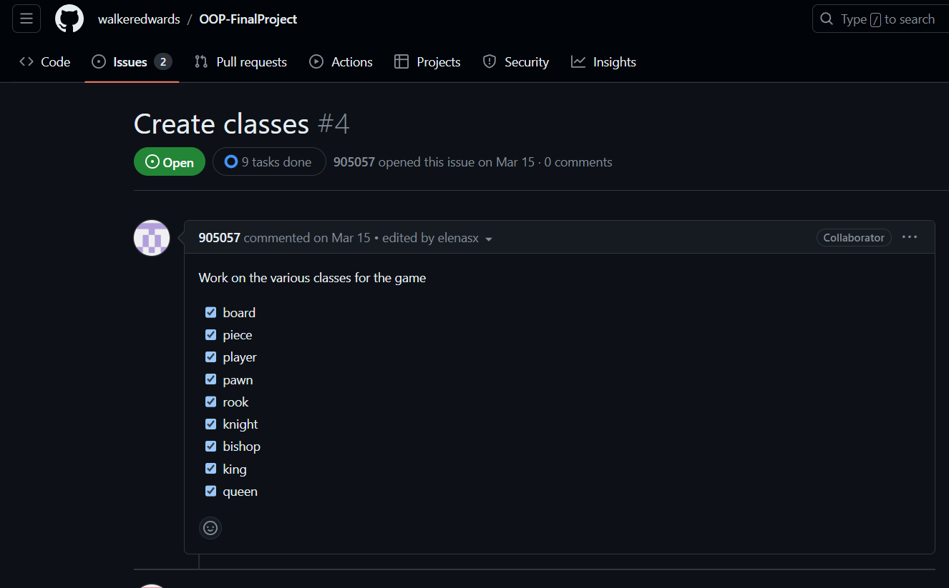
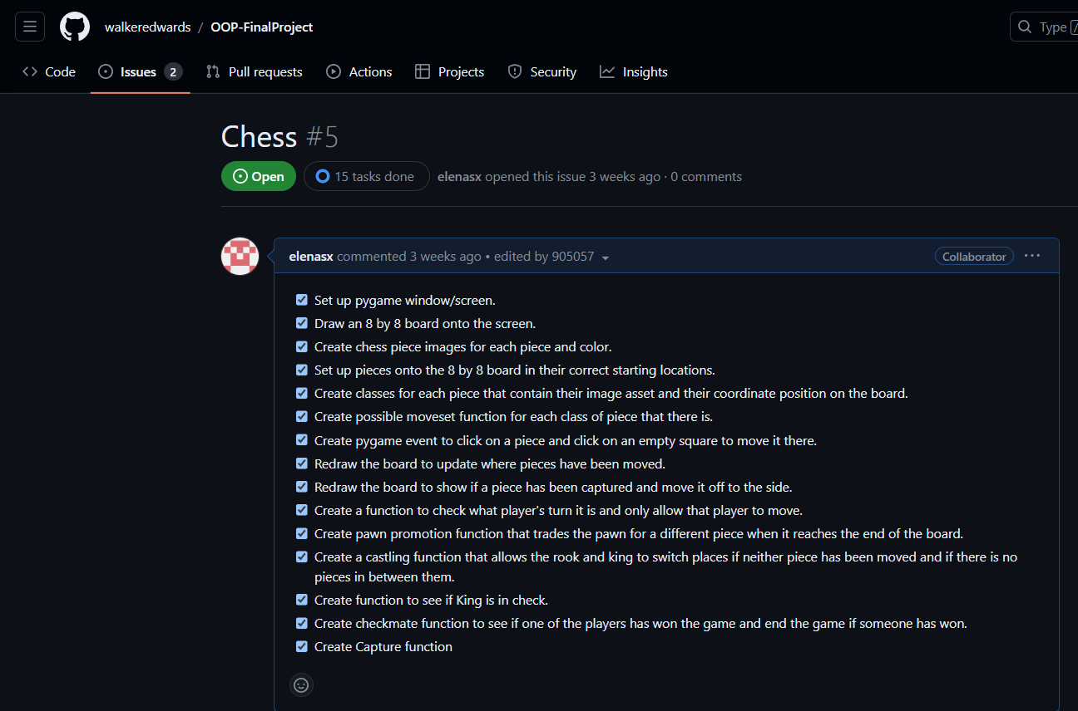
Software management
https://github.com/walkeredwards/OOP-FinalProject

Slide 7
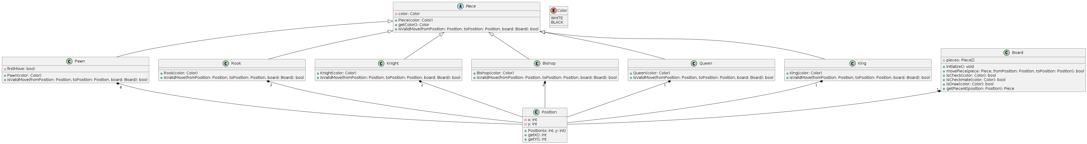
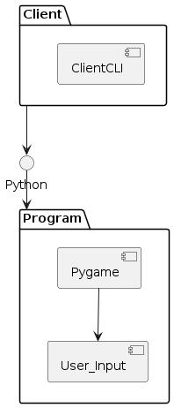
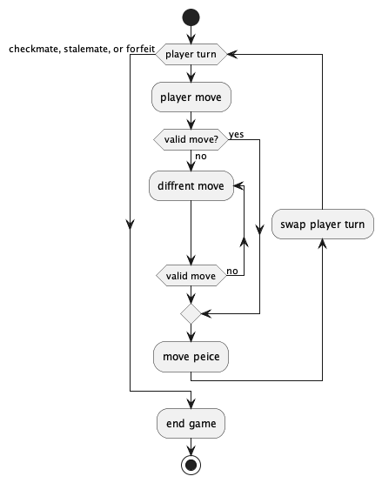
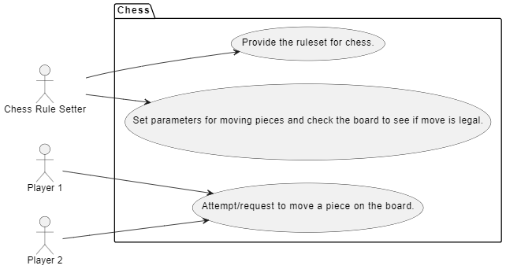
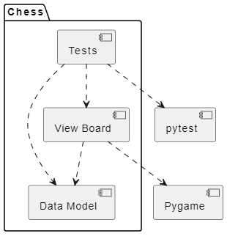
4+1 Views
Logic
Development
Context
Physical
Process

